Slide 1
Name Artist & Title
Game 0001

Slide 2
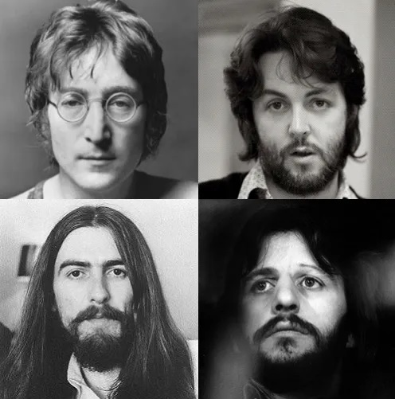
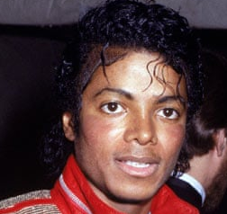
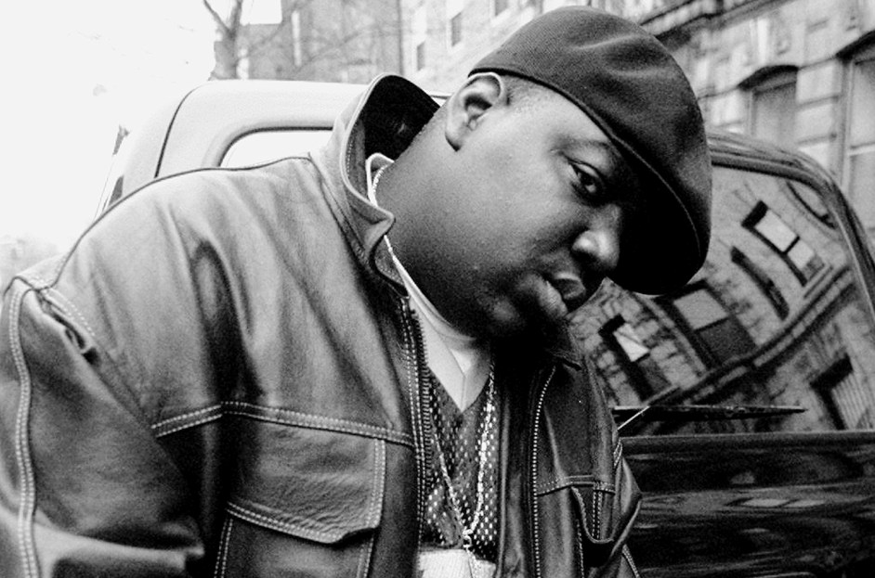
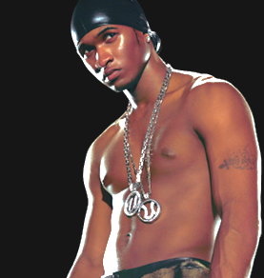
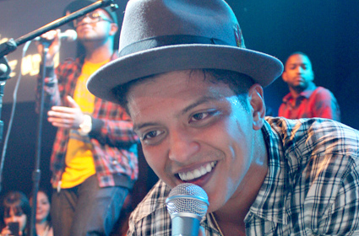
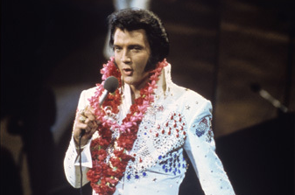
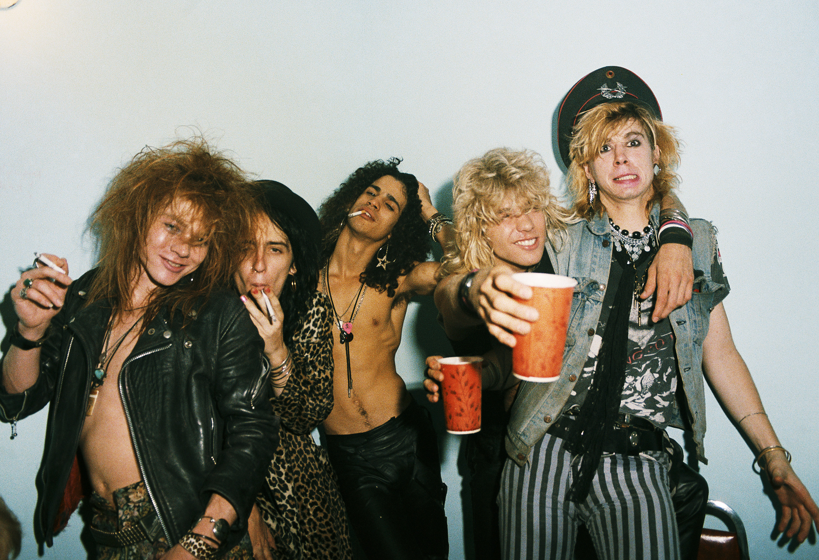
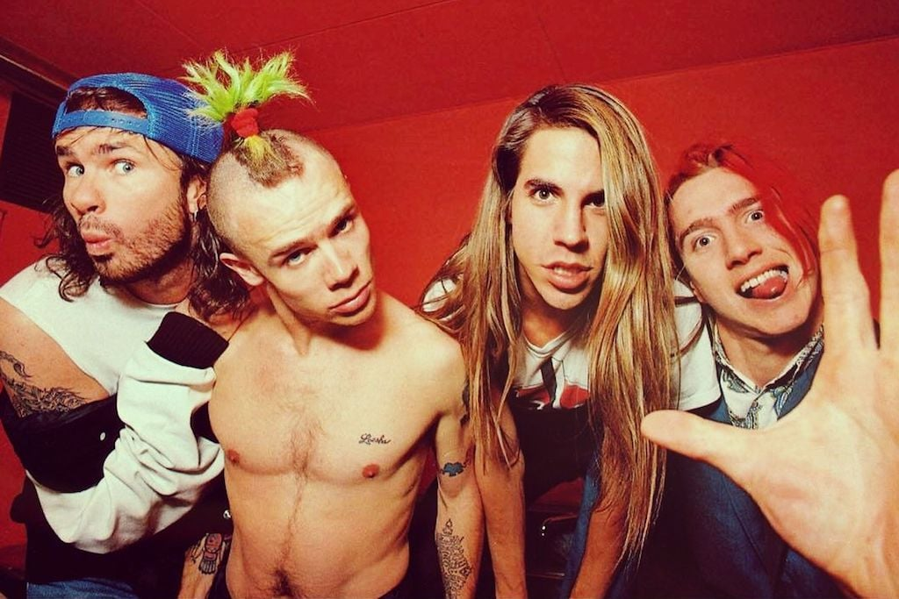
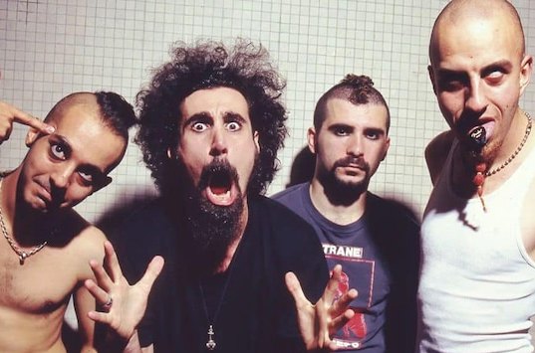
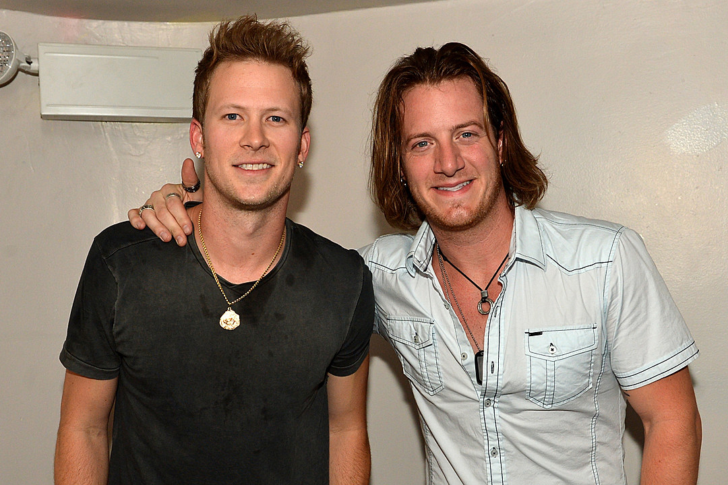
Picture Round
Instructions: Identify the artist or group on the line under each image

Slide 3
Decades In what decade was this version of the song originally released?

Slide 4
General Knowledge
Having been covered by over 50 artists, which Simon & Garfunkel 5-Grammy-winning hit is considered their most successful single? Bridge Over Troubled Water
”I’ve seen a million faces and I’ve rocked them all” is a lyric from what wildly successful 1987 single? Wanted Dead or Alive (Bon Jovi)
From Christina Aguilera’s 1999 debut album: What A Girls Wants, Come On Over Baby, and what other song reached #1 of the US Billboard Hot 100, while earning her a Grammy for Best New Artist? Genie In A Bottle
In 2009 Jay-Z wrote a song about his hometown that took the charts by storm. Name the song. Empire State of Mind
What band opened their 2019 Super Bowl halftime show with the song Harder to Breathe? Maroon 5
The disastrous 2017 Fyre Festival (about which Hulu and Nexflix both stream documentaries now) was a fraudulent music festival founded by Billy McFarland and what award-winning American rapper of Livin’ It Up fame? Ja Rule
With chart-topping hits like Can’t Get Enough of Your Love, Babe and You’re the First, the Last, My Everything”, who was nicknamed “The Walrus of Love”? Barry White
Name the country superstar whose song He Stopped Loving Her Today reached #1 in 1980. George Jones
During her legendary 1992 Saturday Night Live performance of Nothing Compares 2 U, whose photo did Irish singer Sinead O’Connor tear into 8 pieces? The Pope’s (Pope John Paul II)
In 2014 Apple acquired Beats Electronics LLC, an audio product manufacturer. Name the rapper and record producer who co-founded the company in 2006. Dr. Dre
Since 2018, numerous lawsuits have been filed against Billy McFarland, the previously mentioned Fyre Festival fraudster. What is the highest dollar amount in one lawsuit that he’s currently being sued for? $100 million

Slide 6
The Beatles
Michael Jackson
The Notorious B.I.G.
Usher
Bruno Mars
Elvis Presley
Guns N’ Roses
Red Hot Chili Peppers
System of a Down
Florida Georgia Line

